Slide 1
Terraform – Getting Started

Slide 2

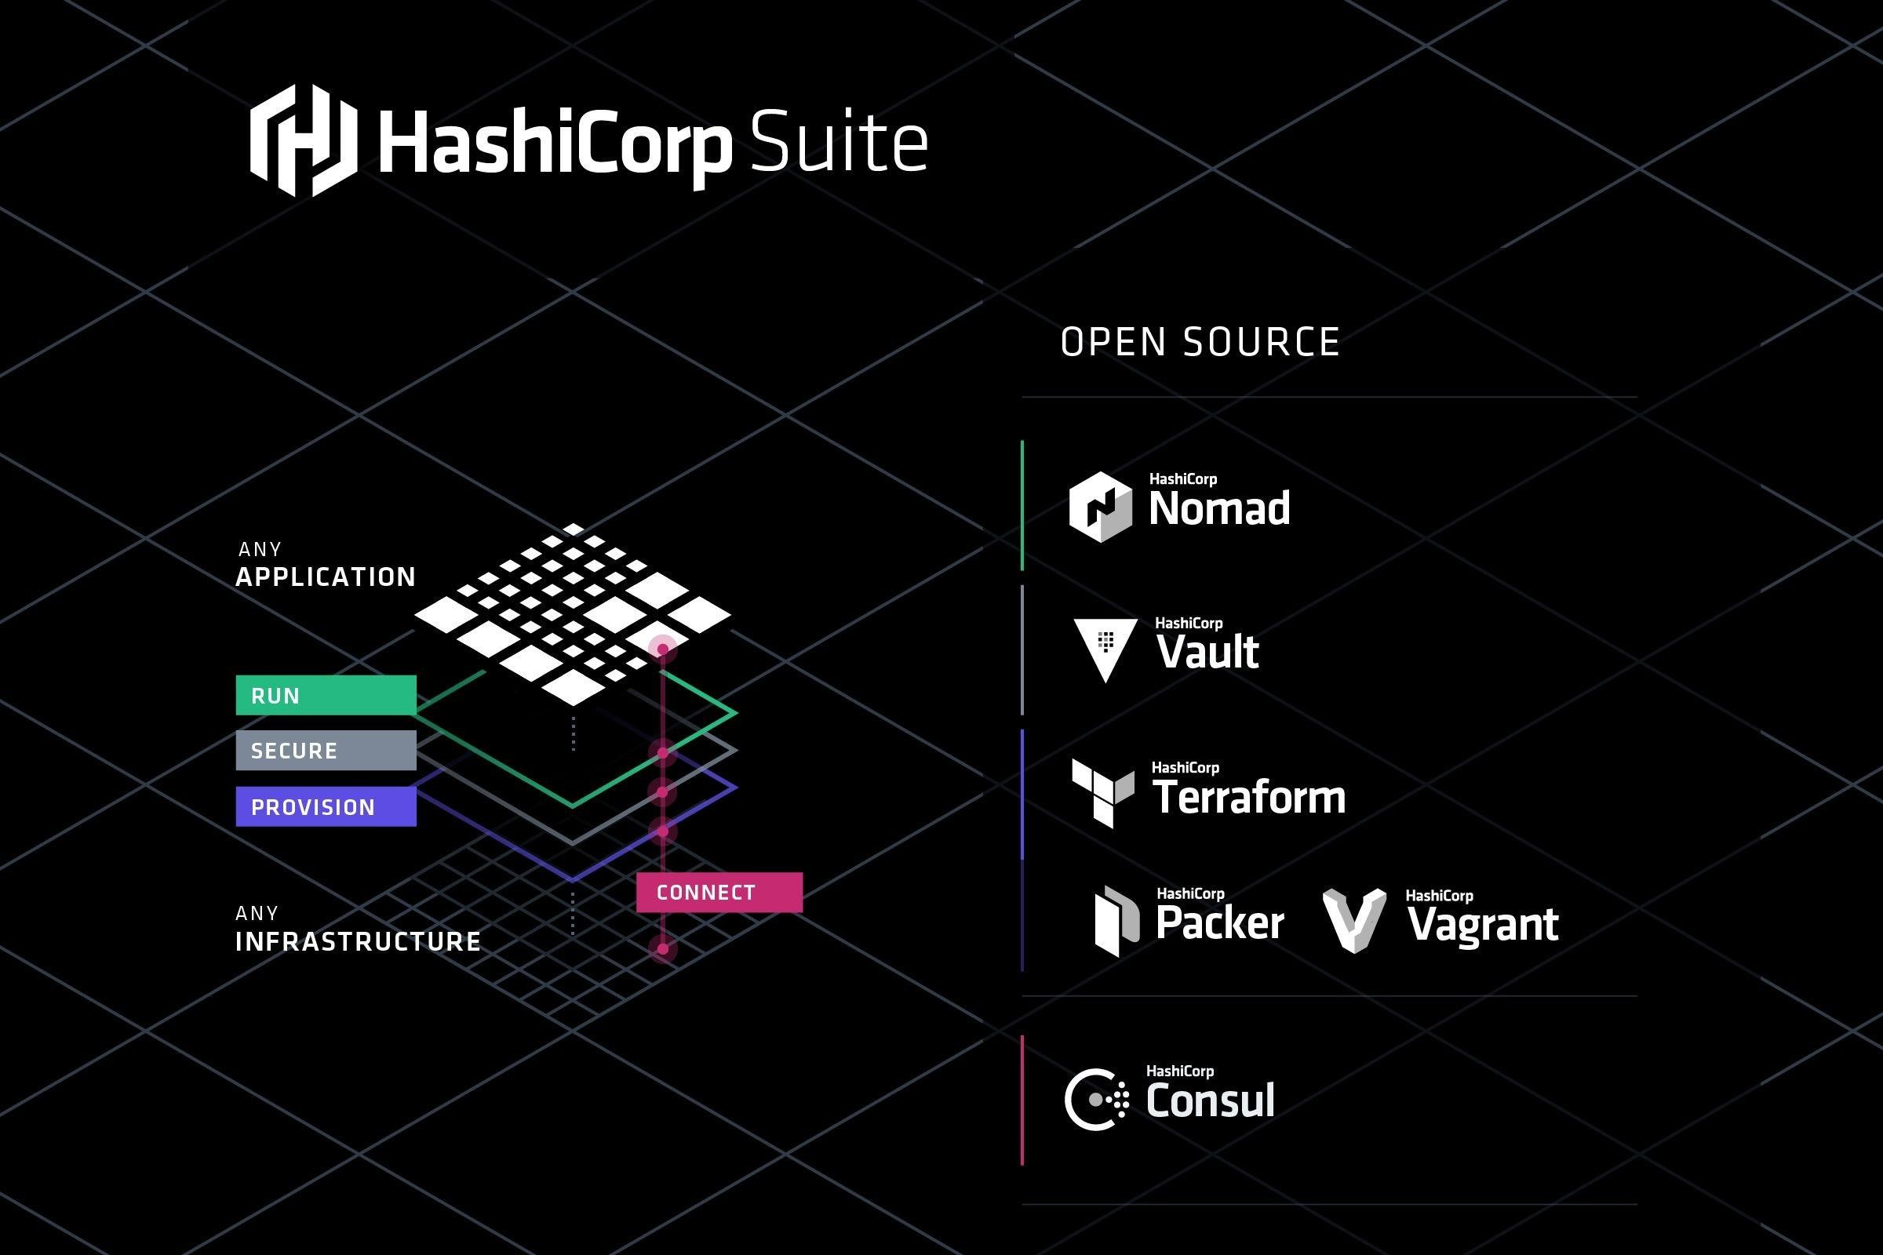

Slide 3
Provisioning infrastructure through software to achieve
consistent and predictable
environments.

Slide 4
Core Concepts
Defined in code
Stored in source control
Declarative or imperative
Idempotent and
consistent
Push or pull

Slide 5

Infrastructure as Code Benefits
Automated deployment Consistent environments
Repeatable process Reusable components
Documented architecture

Slide 6




Automating Infrastructure Deployment
Provisioning
Resources
Planning
Updates
Using Source
Control
Reusing
Templates

Slide 7
Terraform
A provisioning declarative tool that based on Infrastructure as a Code paradigm
Uses own syntax - HCL (Hashicorp Configuration Language)
Written in Golang.
Helps to evolve you infrastructure, safely and predictably
Applies Graph Theory to IaaC
Terraform is a multipurpose composition tool:
Composes multiple tiers (SaaS/PaaS/IaaS)
A plugin-based architecture model
Open source. Backed by Hashicorp company and
Hashicorp Tao (Guide/Principles/Design)

Slide 8








Other tools
Cloudformation, Heat, etc.
Ansible, Chef, Puppet, etc.
Boto, fog, apache-libcloud, etc.
Custom tooling and scripting

Slide 9
AWS Cloudformation VS OpenStack Orchestration (Heat)
AWS Locked-in
Initial release in 2011
Sources hidden behind a scene
AWS Managed Service / Free
Cloudformation Designer
Drag-and-drop interface.
Json, Yaml (since 2016)
Rollback actions for stack updates
Change sets (since 2016)
Open source
Initial release around 2012
Heat provides
CloudFormation-compatible
Query API for Openstack
UI: Heat Dashboard
Yaml

Slide 10
Ansible, Chef, Puppet, etc
Created for the purpose to be a configuration management tool.
Suggestion: don’t try to mix configuration management and resource
orchestration.
Different approaches:
Declarative: Puppet, Salt
Imperative: Ansible, Chef
The steep learning curve if you want to use orchestration capabilities of some
of these tools.
Different languages and approaches:
Chef - Ruby
Puppet - Json-like syntax / Ruby
Ansible – Yaml | python

Slide 11
Boto, fog, apache-libcloud, etc.
low-level access to APIs
Some libs focused on specific cloud providers, others provide common
interface for few different clouds
Inspires to create custom tooling
Custom tooling and scripting
Error-prone and tedious
Requires many human-hours
The minimum viable features
Slowness or impossibility to evolve, adopt to quickly changing environments

Slide 12
Terraform is not a cloud agnostic tool
It’s not a magic wand that gives you power over all clouds and systems.
It embraces all major Cloud Providers and provides common language to orchestrate your infrastructure resources.

Slide 13
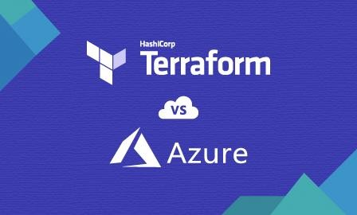

Slide 14
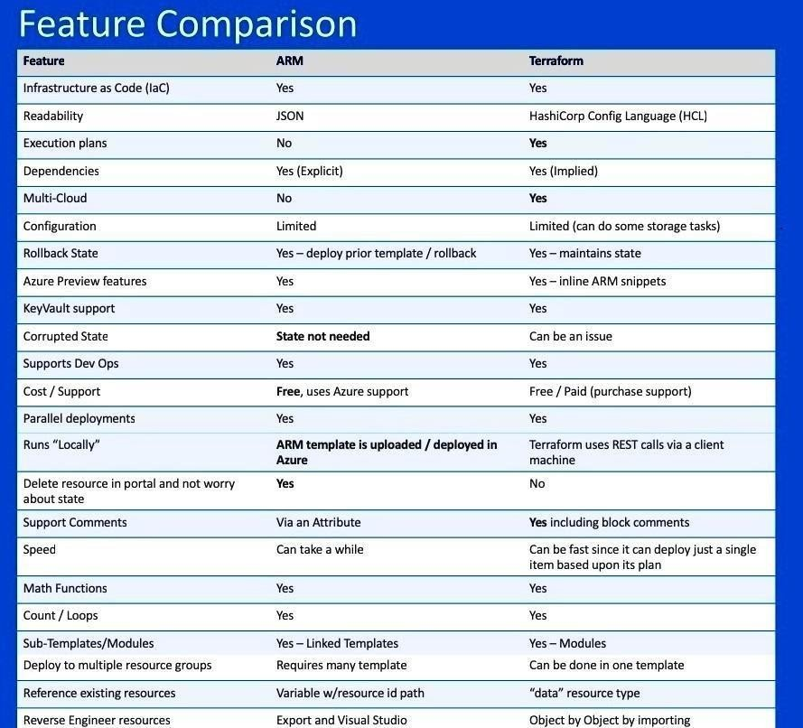

Slide 15
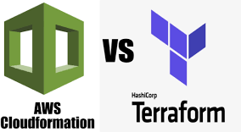

Slide 16
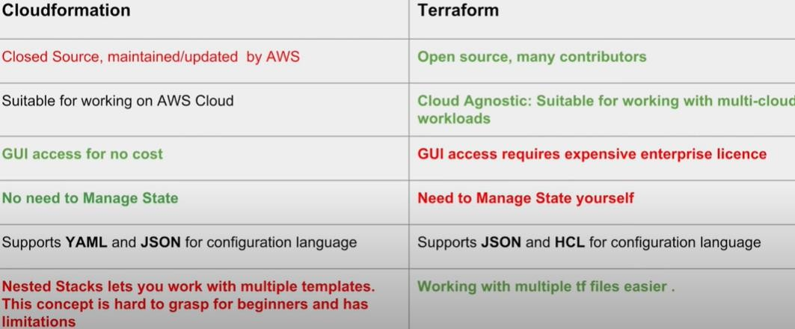

Slide 17
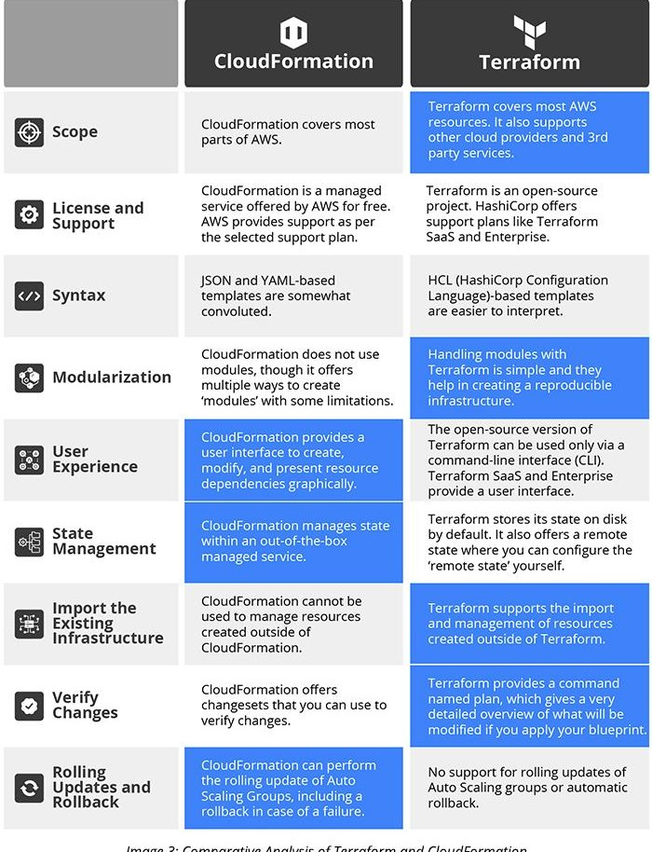

Slide 18
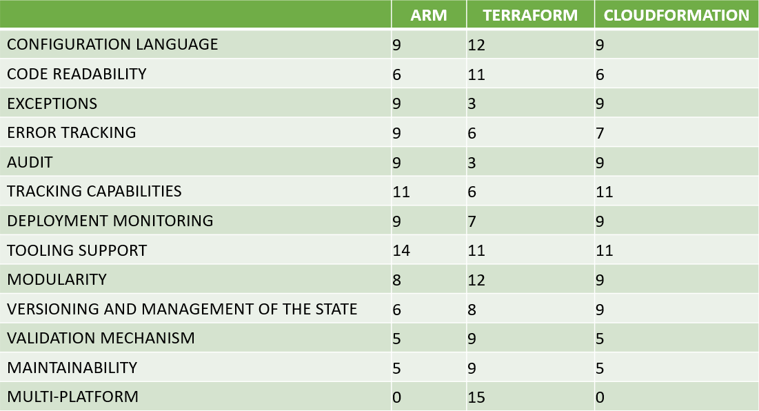

Slide 19
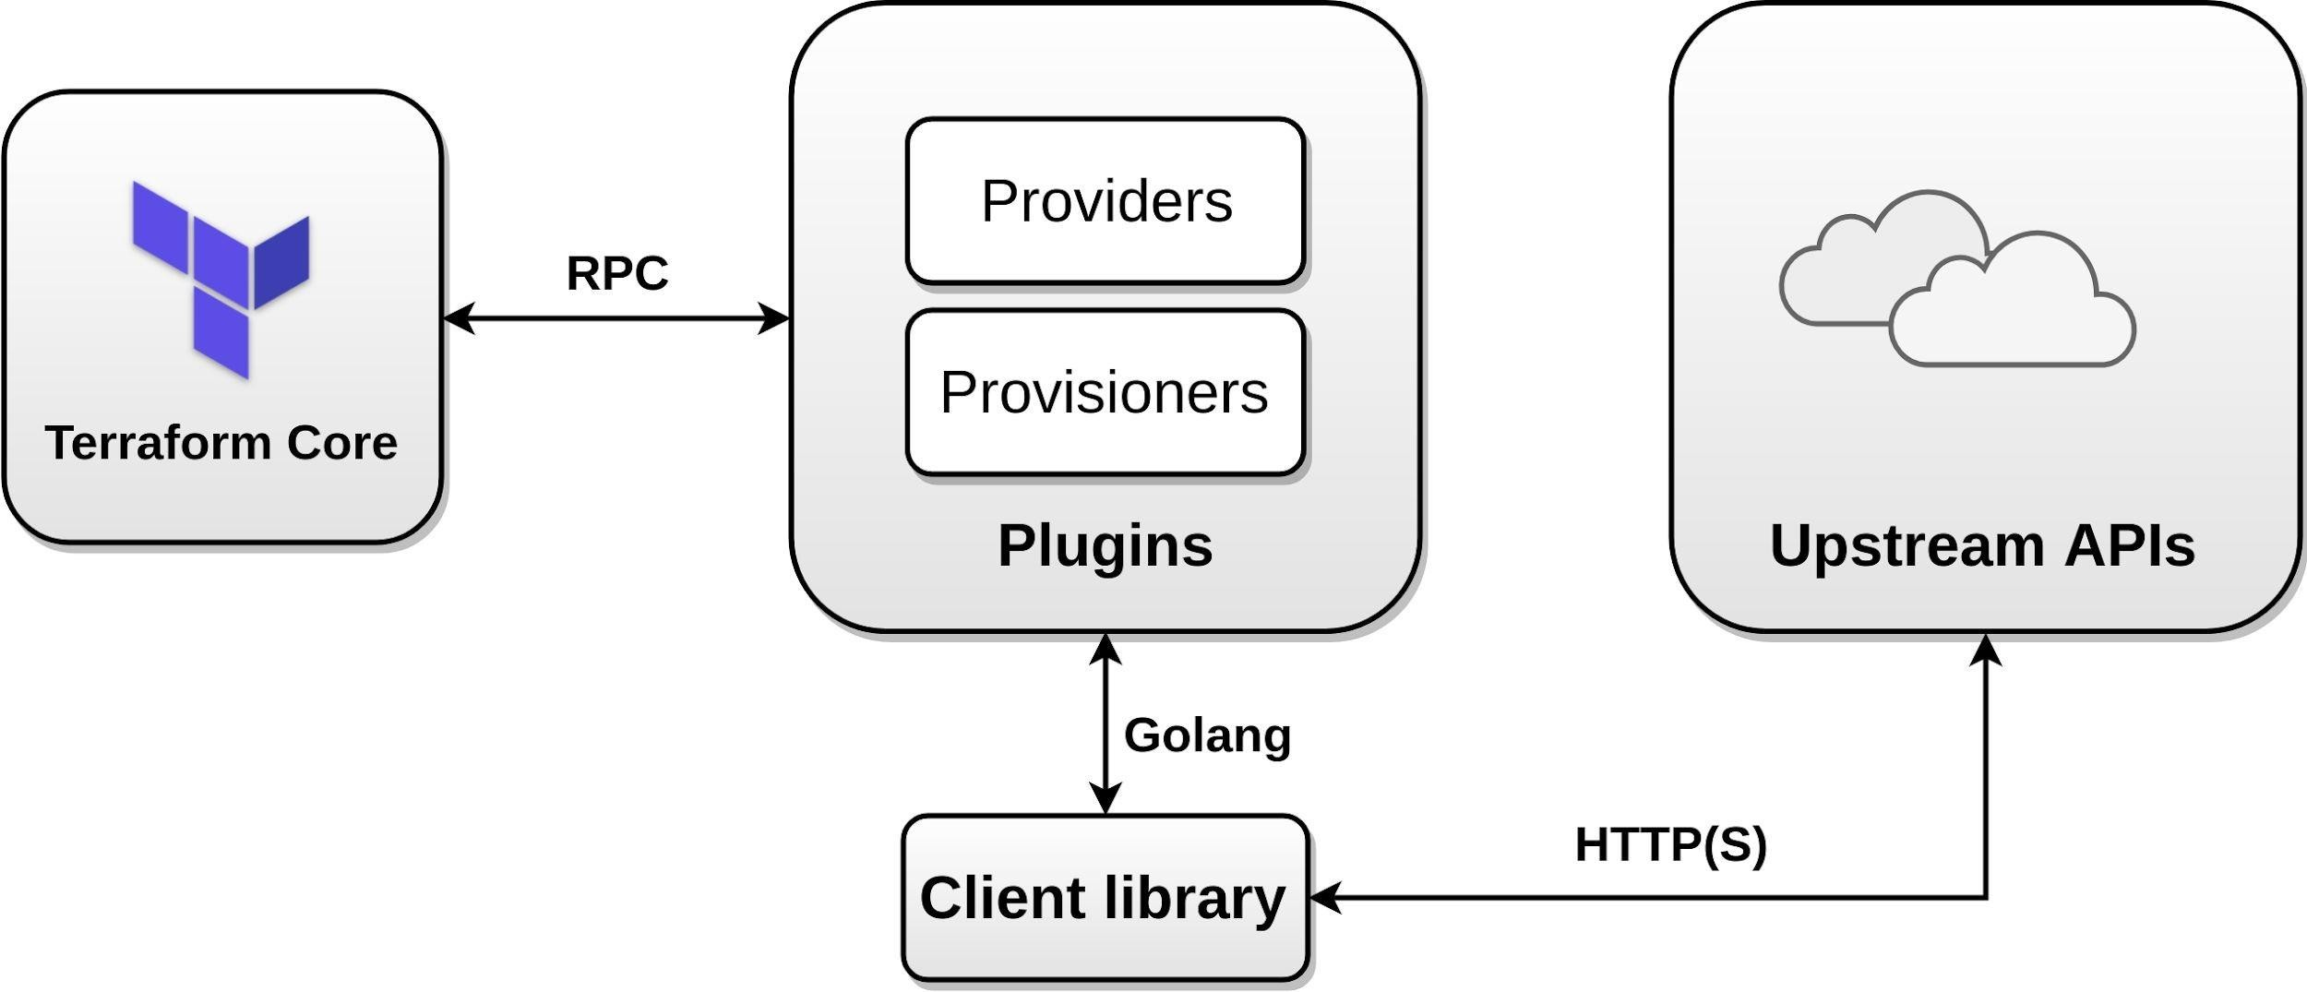
Architecture

Slide 20
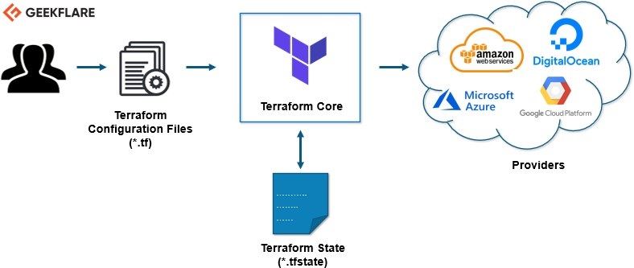
Architecture

Slide 21
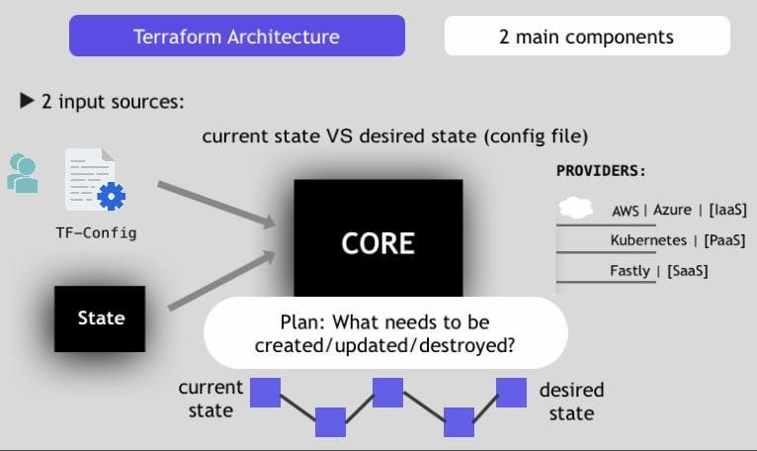
Architecture

Slide 22
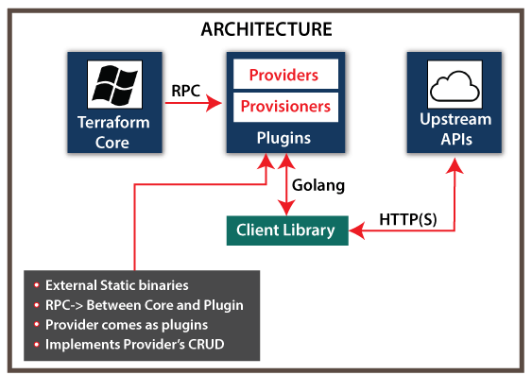
Architecture

Slide 23
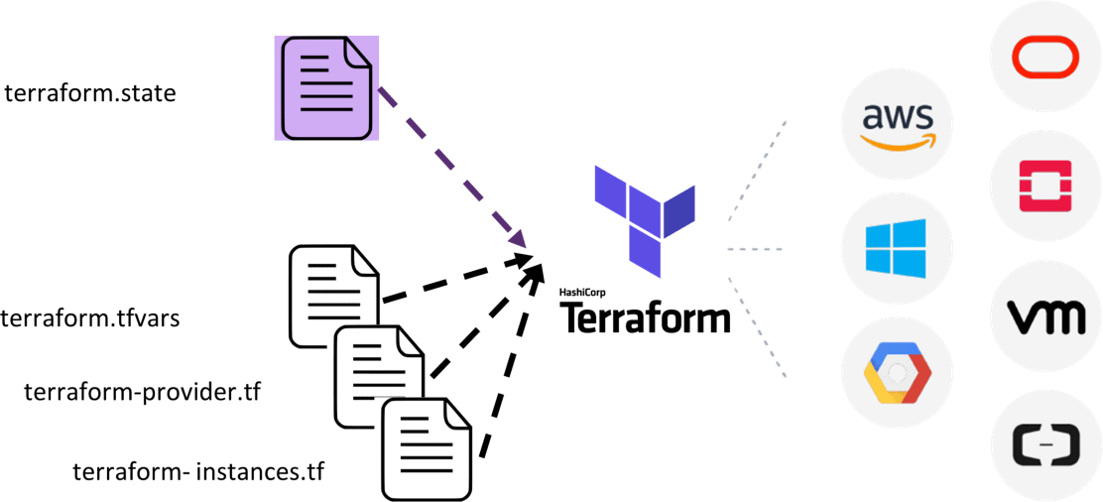
Architecture

Slide 24
Terraform Components
Terraform Executable
Terraform Providers API
Terraform File
Terraform Statefile Terraform config file

Slide 25
Terraform Executable

Slide 26
Terraform Providers

Slide 27

Terraform Providers
IaaS, PaaS, and SaaS
Community and HashiCorp
- AWS, Azure, GCP, and Oracle
Open source using APIs
Resources and data sources Multiple instances

Slide 28
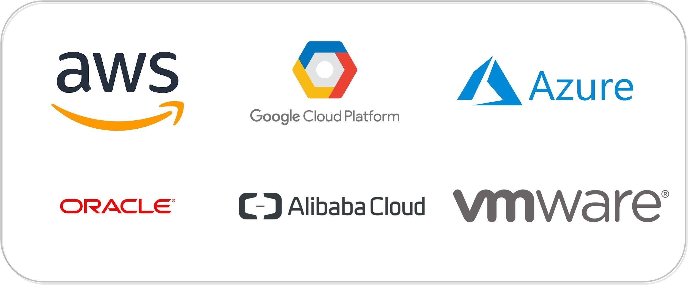
Terraform: Providers (Plugins)
1125+ infrastructure providers
Major Cloud Partners

Slide 29



Terraform: Providers
Can be integrated with any API using providers framework
Note: Terraform Docs → Extending Terraform → Writing Custom Providers
OpenFaaS
OpenAPI
Generic Rest API
Stateful
Docker
Kubernetes
Nomad
Consul
Vault
Terraform :)
GitLab
GitHub
BitBucket
DNS
Palo Alto Networks
F5 BIG-IP
Template
Random
Null
External
(escape hatch)
Archive
NewRelic
Datadog
PagerDuty
Digital Ocean
Fastly
OpenStack
Heroku

Slide 30
Provider Example
provider “azurerm” {
subscription_id = “subscription-id” client_id = “principal-used-for-access”
client_secret = “password-of-principal” tenant_id = “tenant-id”
alias = “arm-1”
}

Slide 31
Terraform Code

Slide 32

Terraform Syntax
HashiCorp configuration language
Why not JSON?
Human readable and editable
Interpolation
Conditional, functions, templates

Slide 33
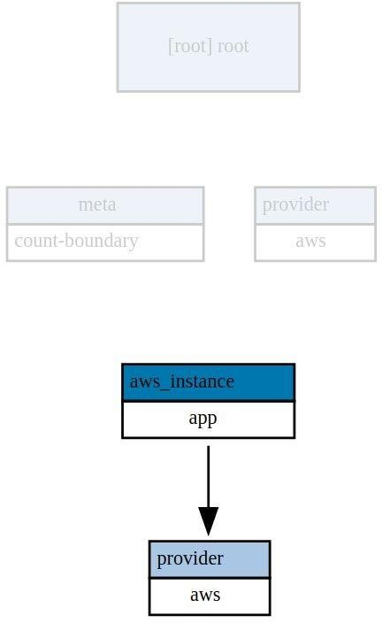
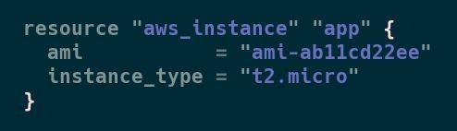
Terraform: Example (Simple resource)
Type
Name

Slide 34
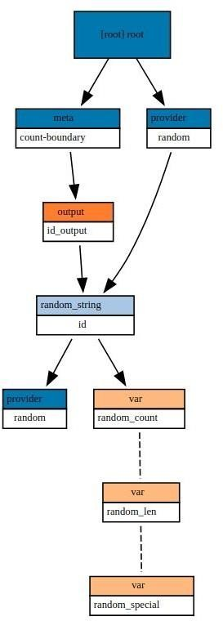
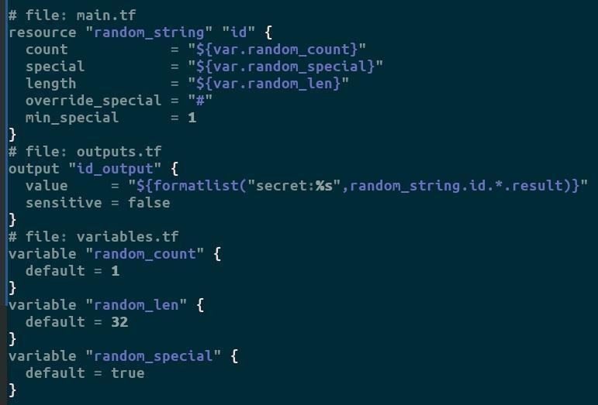
Terraform: Example (Simple local resource)

Slide 35

Variables
variable | "aws_access_key" | {}
variable | "aws_secret_key" | {}
provider "aws" {
Provider
access_key = "access_key“ secret_key = “secret_key” region = “us-east-1”
}

Slide 36
Resource
resource "aws_instance" "ex"{
ami = "ami-c58c1dd3"
instance_type = "t2.micro"
}
output "aws_public_ip" {
Output
value = "${aws_instance.ex.public_dns}"
}

Slide 37
Code Example
provider “azurerm” {
subscription_id = “subscription-id” client_id = “principal-used-for-access”
client_secret = “password-of-principal” tenant_id = “tenant-id”
alias = “arm-1”
}
resource “azurerm_resource_group”{ name = “resource-group-name”
location = “East US”
provider = “azurerm.arm-1”
}

Slide 38
Terraform Syntax
#Create a variable
variable var_name {
key = value #type, default, description
}
#Use a variable
${var.name} #get string
${var.map[“key”]} #get map element
${var.list[idx]} #get list element

Slide 39
Terraform Syntax
#Create provider
provider provider_name {
key = value #depends on resource, use alias as needed
}
#Create data object
data data_type data_name {} #Use data object
${data_type.data_name.attribute(args)}

Slide 40
Terraform Syntax
#Create resource
resource resource_type resource_name {
key = value #depends on resource
}
#Reference resource
${resource_type.resource_name.attribute(args)}

Slide 41
Terraform Workflow

Slide 42
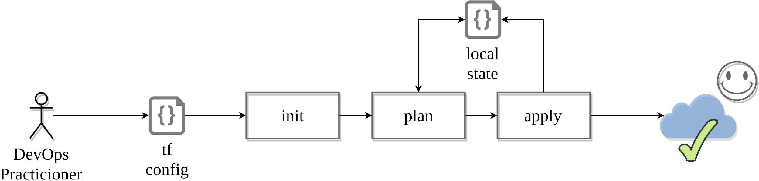
Workflow: Adoption stages
Single contributor

Slide 43
Terraform Core: Init
This command will never delete your existing configuration or state.
Checkpoint → https://checkpoint.hashicorp.com/
.terraformrc → enable plugin_cache_dir, disable checkpoint
Parsing configurations, syntax check
Checking for provisioners/providers (by precedence, only once)→
“.”, terraform_bin_dir, terraform.d/plugins/linux_amd64
.terraform/plugins/linux_amd64
File lock.json contains sha-512 plugin hashes (.terraform)
Loading backend config ( if it’s available, local instead )
Backend Initialization: Storage for terraform state file.

Slide 44
Terraform Core: Plan + Apply
Starting Plugins: Provisioners/Providers
Building graph
Terraform core traverses each vertex and requests each provider using parallelism
Providers syntax check: resource validation
If backend == <nil>, use local
If “-out file.plan” provided - save to file - the file is not encrypted
Terraform Core calculates the difference between the last-known state and
the current state
Presents this difference as the output of the terraform plan operation to user
in their terminal

Slide 45
Terraform Core: Destroy
Measure twice, cut once
Consider -target flag
Avoid run on production
No “Retain” flag - Remove resource from state file instead
terraform destroy tries to evaluate outputs that can refer to non existing
resources #18026
prevent_destroy should let you succeed #3874
You can’t destroy a single resource with count in the list

Slide 46
Terraform state

Slide 47

Terraform State
JSON format (Do not touch!) Resources mappings and metadata
Locking
Local / remote Environments

Slide 48
Terraform state file
Backup your state files + use Versioning and Encryption
Do Not edit manually!
Main Keys: cat terraform.tfstate.backup | jq 'keys'
"lineage" - Unique ID, persists after initialization
"modules" - Main section
"serial" - Increment number
"terraform_version" - Implicit constraint
"version" - state format version
Use “terraform state” command
mv - to move/rename modules
rm - to safely remove resource from the state. (destroy/retain like)
pull - to observe current remote state
list & show - to write/debug modules

Slide 49
Terraform State
Terraform keeps the remote state of the infrastructure
It stores it in a file called terraform.tfstate
There is also a backup of the previous state in terraform.tfstate.backup
When you execute terraform apply, a new terraform.tfstate and backup is written
This is how terraform keeps track of the remote state
If the remote state changes and you hit terraform apply again, terraform will make changes to meet the correct remote state again
e.g. you terminate an instance that is managed by terraform, after terraform apply it will be started again
•

Slide 50
Terraform State
You can keep the terraform.tfstate in version control
e.g. git
It gives you a history of your terraform.tfstate file (which is just a big JSON file)
It allows you to collaborate with other team members
Unfortunately you can get conflicts when 2 people work at the same time
Local state works well in the beginning, but when you project becomes bigger, you might want to store your state remote

Slide 51
Terraform State
The terraform state can be saved remote, using the backend functionality in terraform.
The default is a local backend (the local terraform state file) Other backbend's include:
s3 (with a looking mechanism using dynamoDB)
consul (with locking)
terraform enterprise (the commercial solution)

Slide 52
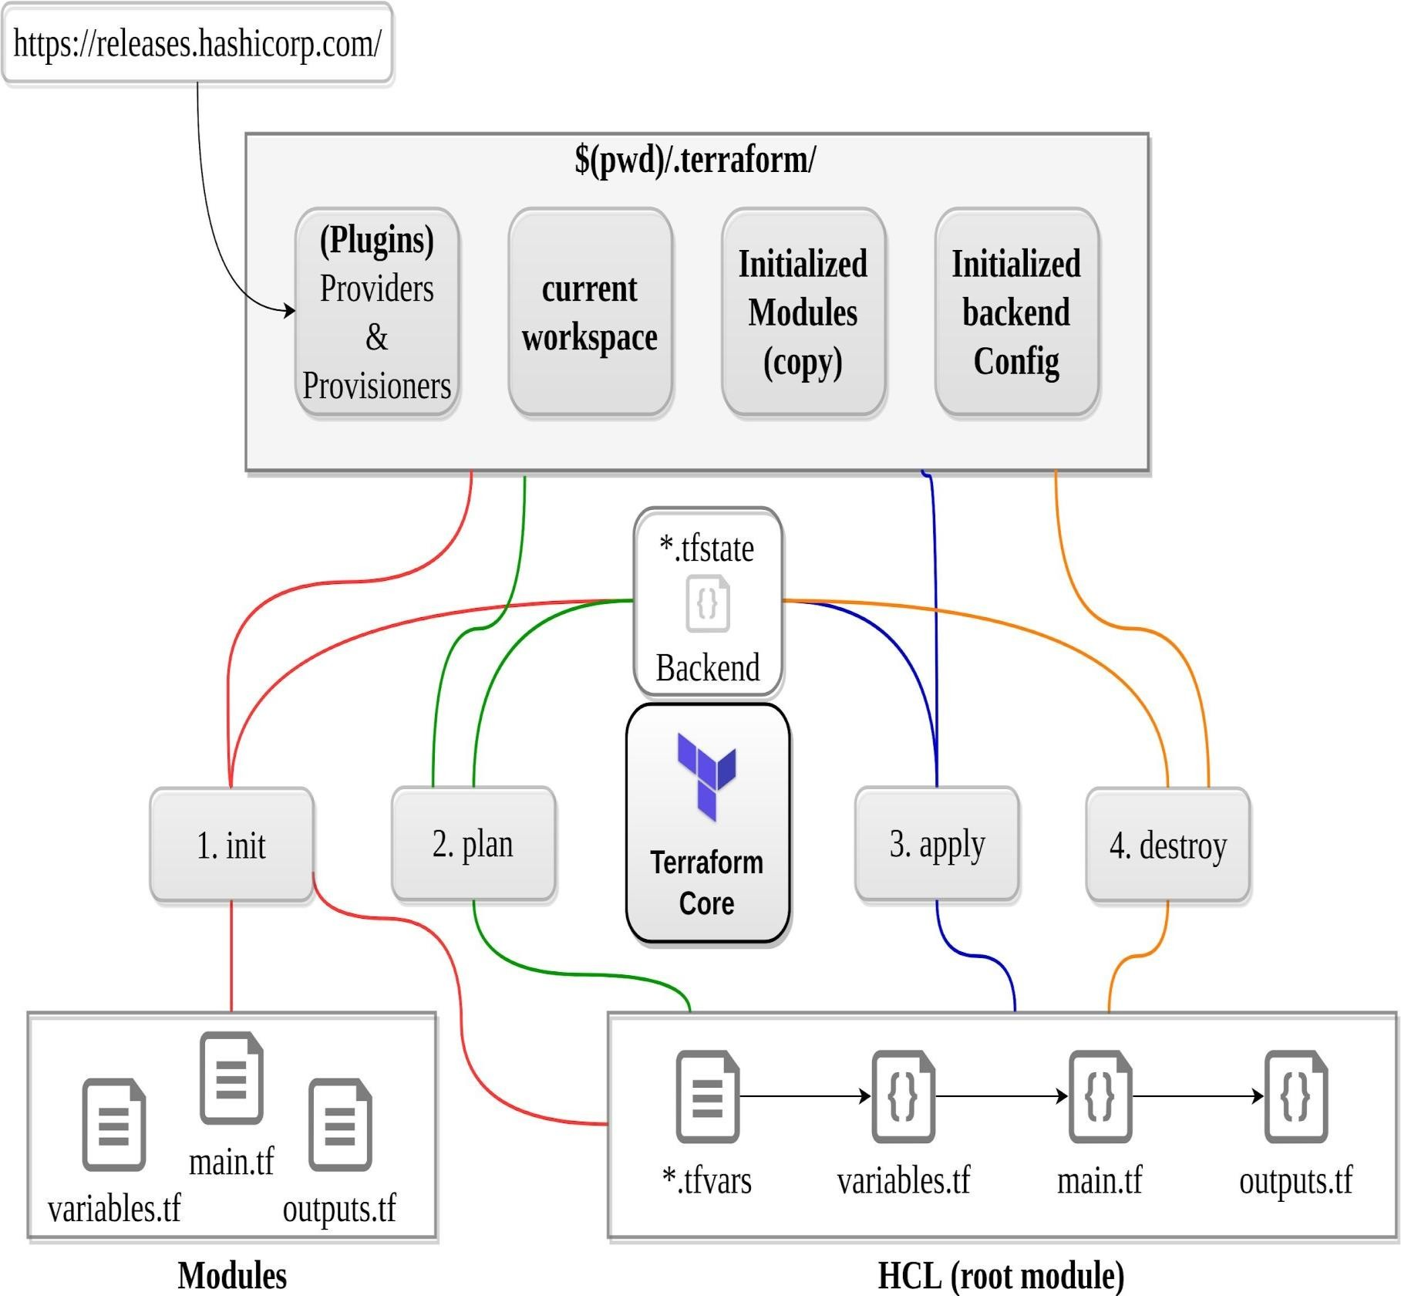
Simple workflow

Slide 53
UpdatingYour Configuration with More Resources

Slide 54
Adding a New Provider to Your Configuration

Slide 55
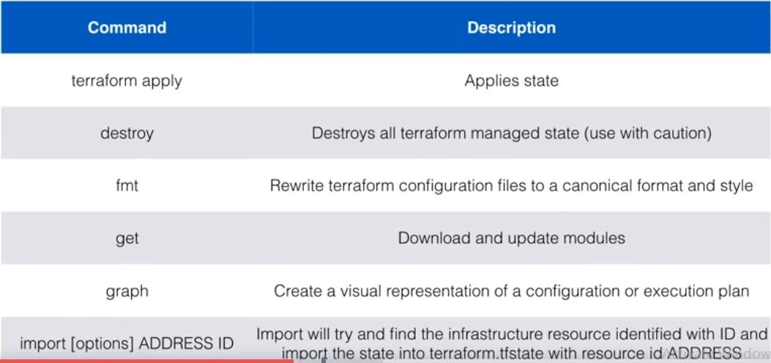
Terraform Command Overview

Slide 56
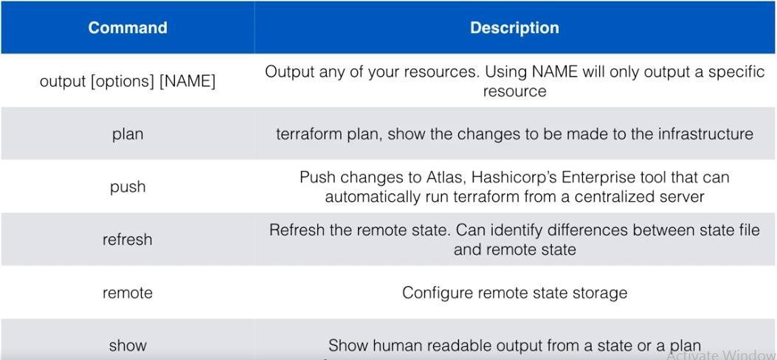
Terraform Command Overview

Slide 57
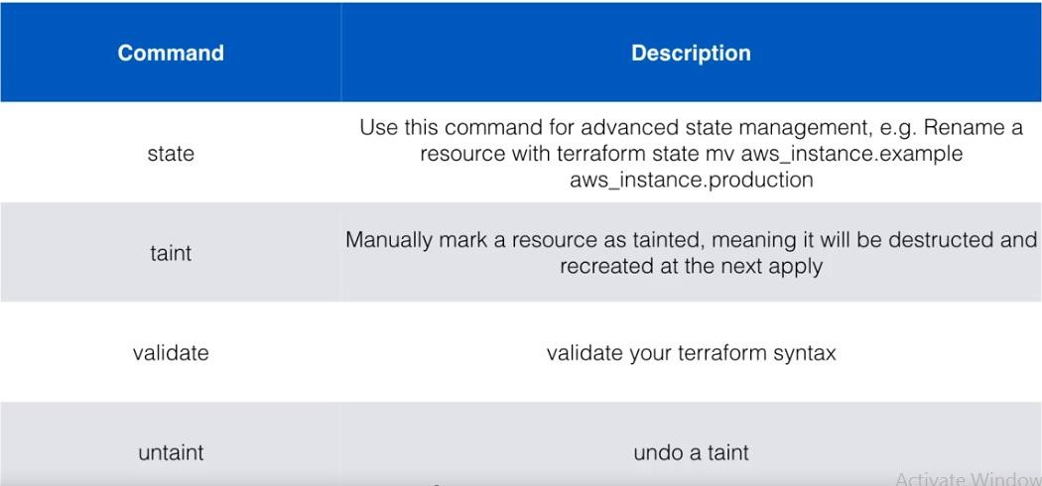
Terraform Command Overview

Slide 58
Terraform Advance Workflow

Slide 59
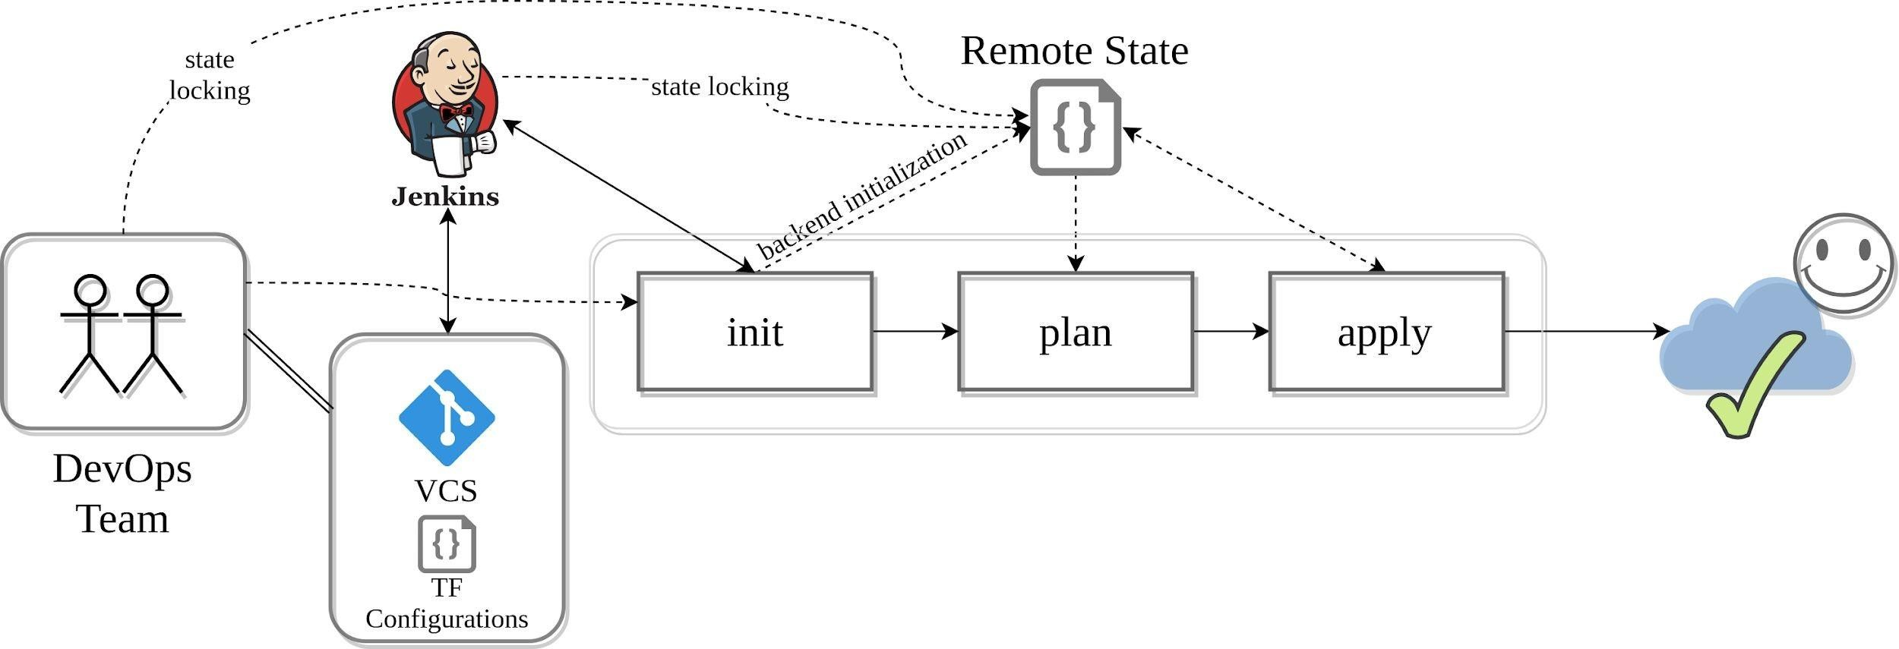
Workflow: Adoption stages
Team Collaboration

Slide 60
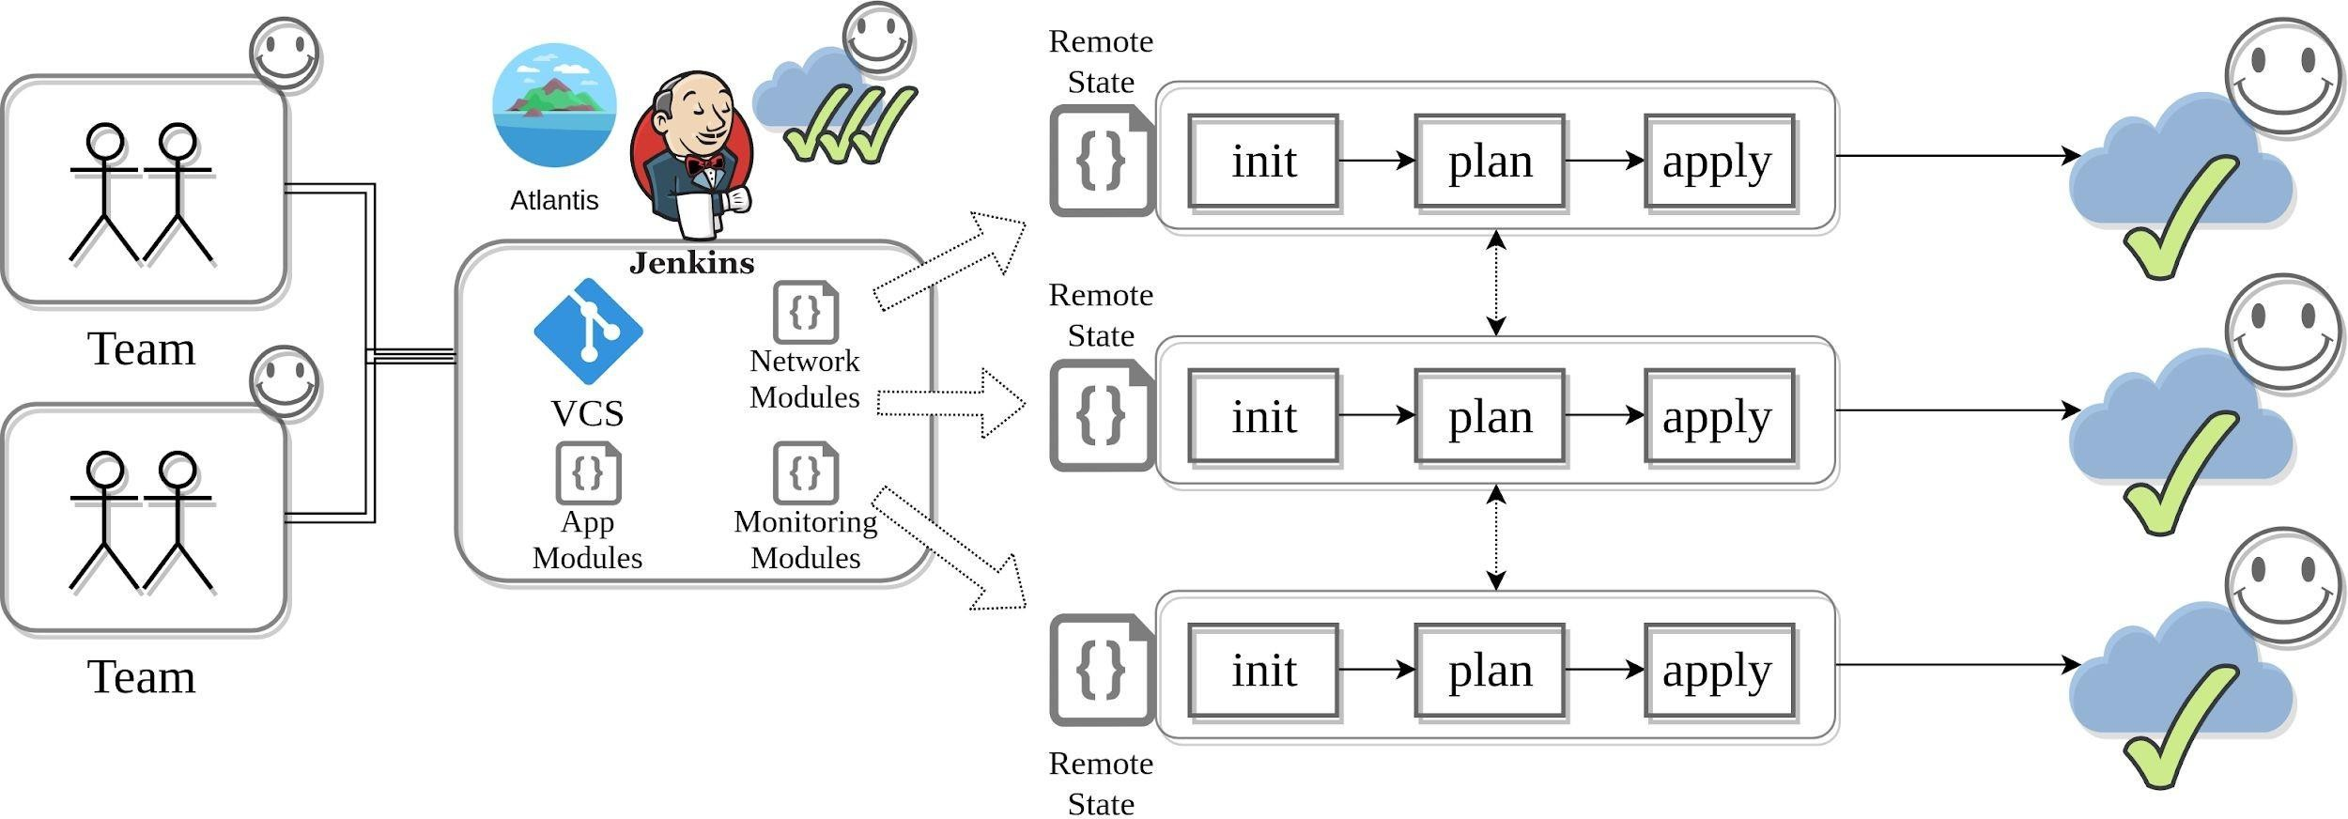
Workflow: Adoption stages
Multiple Teams

Slide 61

Examine the Terraform file
Deploy the configuration
Review the results
Demo
Play along!
AWS account
Demo files

Slide 62
Examine the Terraform file
Deploy theconfiguration
Review theresults Play along!
Demo
AWS account
Azure subscription
DNS domain
Terraform software (terraform.io)
Demo files

Slide 63
Examine the Terraform file Deploy the configuration
Review the results
Demo
Play along!
AWS account
Terraform software (terraform.io)
Demo files

Slide 64
Examine the Terraform file Deploy the configuration
Review the results
Demo
Play along!
AWS account
Terraform software (terraform.io)
Demo files

